Slide 1
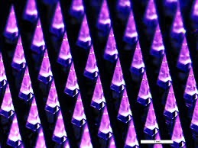




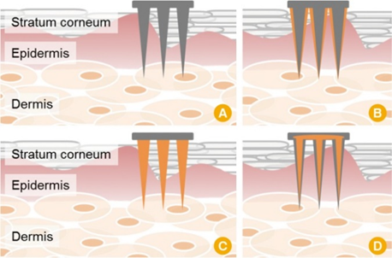
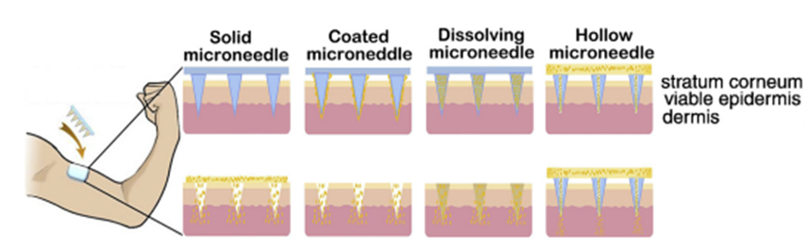
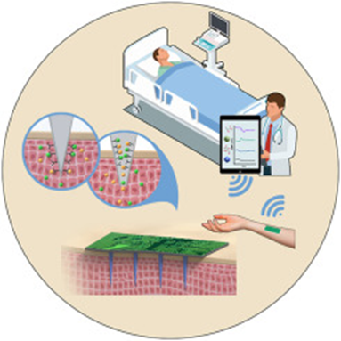
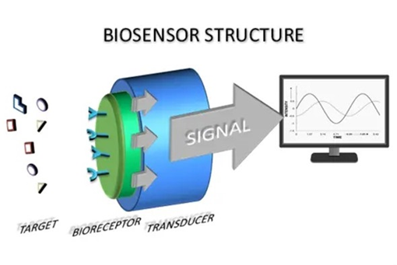
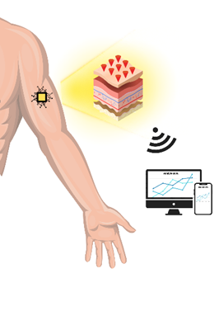
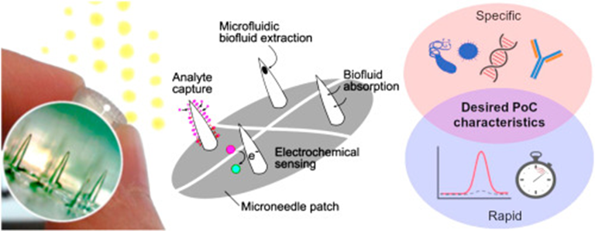

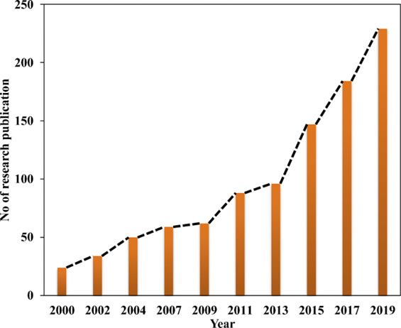
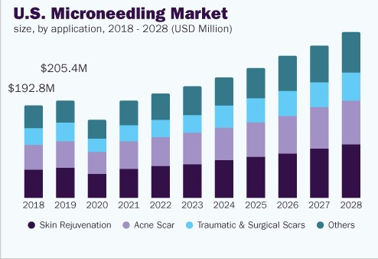
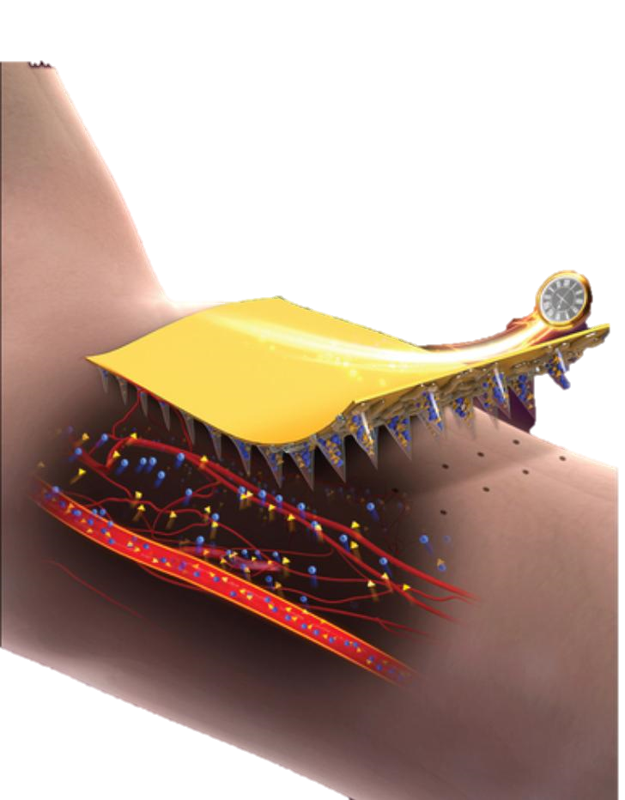
MICRONEEDLE BASED BIOSENSOR TECHNOLOGIES
Gozde Sultan Kaya¹, Ece Oz ¹, Berivan Erikli ¹ , Gokay Vardar ²
1-Istanbul Health And Technology University, Nutrition and Dietetics Department, Istanbul, Turkey
2- Istanbul Health And Technology University, Vocational School of Health Services Faculty, Istanbul, Turkey
Abstract
What are microneedles?
A biosensor, which has been known and used for a long time, is an analytical tool that combines a biological element with a physicochemical detector to detect a chemical compound¹. A new perspective on therapies can be generated with numerous advantages when biosensors and microneedles are combined. Biomarkers like nucleic acid, proteins, tiny compounds, and even cells from interstitial skin fluid (ISF) have been detected using microneedles (MNs) for early diagnosis and real-time monitoring.² Considering these characteristics, microneedle-based biosensors have the potential to decrease hospital stays, follow up with patients more effectively, prevent re-hospitalizations, and thus lower expenses. Looking at the main objectives for using MN-based technologies, MNs, who gain from the consistency of their. The focus of this study is to reveal the ways and benefits of the use of microneedle patched biosensors, technologies that serve the benefit of people in the rapidly developing world in the field of health, as in many other field.³
A solid or hollow cannula with an insertion length of 20 to 1500 microns and an outer diameter of no more than 30 microns is referred to as a microneedle. On the skin layer, they makes minimally holes to deliver which they carries. For variety of usage; they have different types; solid mironeedle(A), coated microneedle(B), dissolving microneedle(C), hollow microneedle(D). The four type of microneedles are given below:
Desmopressine, Diclofenac, Lidocaine
Insulin, Bovine serum albumin
What are biosensors?
ECG,EEG Measurement
Biosensor term is the short form of the “biological sensor”. It couples a transducer with a biologically generated recognition to enable the quantitative development of a complex biochemical parameter. Schematic representation of a biosensor structure and transducing mechanism is given below:
APPLICATIONS
Drug delivery
Vaccine & Gene delivery
Combination therapy
Ocular drug delivery
Diagnostic tools
Bio-macromolecule delivery
Influenza, measles, Hepatits B, DNA vaccine
With Inotophrosis, Electroporation
Fluosphere delivery to the suprachoridal space of eye
Microneedle based biosensor
Conclusion
Wearable biosensors that monitor and test for biomarkers in order to provide continuous, real-time physiological information. They are getting more attention in the human body in a variety of domains, such as disease treatment, diagnostics, and self-health management. Microneedle based biosensors are one of the ways to obtain wearable biosensors. Thanks to micro-needle biosensors, the desired skin layer can be reached painlessly and adequately. Moreover, drug application or diseased cell monitoring is performed.
Microneedle-based biosensors, which are developing day by day, are a leading application in terms of being minimally invasive and painless compared to traditional applications. Their use satisfies both practitioners and patients. MN based biosensors, which are widely used today due to their advantages, also need some supportive studies. For instance, in the use of that device, new applications should be developed and integrated into the system in order to transmit the health information of individuals wirelessly. In short, the use of microneedle-based biosensors in biomedical applications shows significant promise.
Advantages and disadvantages of
microneedle based biosensors:
Applications of
microneedle based biosensors:
Advantages
Early diagnosis
Minimally invasive
Consistent
Patient satisfaction
Low dose usage
Rapid penetration
Almost painless
Disadvantages
Possibility of allergies
Possibility of irritation
They are too little, so if they break, the pieces will remain under the skin.
Applications
Immunobiological administration
Disease diagnosis
Disease treatment
Cosmetic application
Year Wise (from 2000 to 2019)
Trend in MN Array-Based Research
References
Microneedling Market in U.S.
[1] A. Haleema, M. Javaida, R. Pratap, S. Rajiv, S. Shanay Raba, Biosensors applications in medical fleid: A brief review, Sensors International, 2021, 2, 100100.
[2] Ö. Erdem, Recent Advances in Microneedle-Based Sensors for Sampling, Diagnosis and Monitoring of Chronic Diseases. Biosensors, 2021, 11(9):296.
[3] P. Dardano, I. Rea, L. De Stefano, Microneedles- based electrochemical sensors: New tools for advanced biosensing, Current Opinion in Electrochemistry, 2019. 17, 121-127.

